Slide 1
UNIT – II

Slide 2
Computer being electronic machine cannot understand Symbols & Decimal numbers directly.
This led to the development of separate machine language which is in binary form (0’ & 1’s).
Also the Data to be Processed (Symbols, Characters & Numbers) must also be in binary form (0’s & 1’s).
Therefore various methods of representing Natural Language symbols & Decimal Numbers in Binary form inside the Computer Machine constitute Internal Data Representation.
Accordingly Data can be Organized in groups of Binary Digits (BITS), as Multiples of 8 bits say 16, 32, 64 bits.
A group of 8 bits is termed as one Byte. Now this Byte may represent Internally a number, a character, a special symbol etc.
For example, one Byte may look like.
0 1 0 0 0 0 0 1 🡪 denotes character ‘A’

Slide 3
REPRESENTING BINARY INTEGERS
A computer has to process both positive and negative numbers called signed integers and/or simply signed numbers
Binary integer number can be represented using one of the following schemes:
Signed – Magnitude representation
Signed – 1’s complement representation
Signed – 2’s complement representation
For instance consider -13
Now -13 in binary as recorded in an 8-bit register look like:
1 0001101 🡪 signed – magnitude form
1 1110010 🡪 signed – 1’s complement form
1 1110011 🡪 signed – 2’s complement form

Slide 4
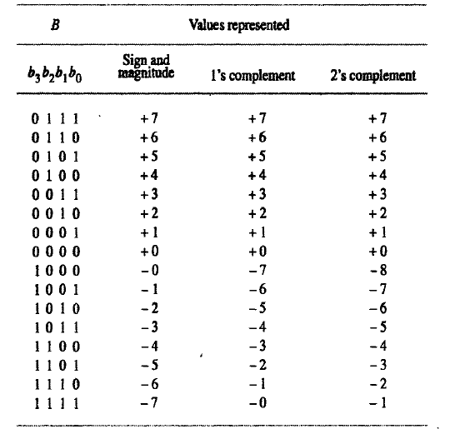

Slide 5
SUMMARY OF THE TABLE
SIGN & MAGNITUE SYSTEM: Negative value is obtained by changing the sign bit (MSB)
SIGNED 1’S COMPLEMENT: Negative number is obtained by complementing each bit of the corresponding positive number i.e (2^{n}-1) –N
SIGNED 2’S COMPLEMENT: Negative number is obtained by taking 2’s complement of positive number
2 ^{n}-N
Range: - (2^{n-1}) to + (2^{n-1}-1)

Slide 6
ADDITION AND SUBSTRACTION OF SIGNED NUMBERS
In unsigned operation if there is a carry from MSB position it is called carry
In signed operations if there is a carry form MSB position it is called end – around – carry
For signed arithmetic operations 2’s complement format is used
For signed arithmetic operation sign and magnitude and 1’s complement format is not suitable

Slide 7
Rules for addition and subtraction of n – bit signed numbers using 2’s complement representation
Addition of two n bit numbers:
Add n bits including sign bit and ignore carry – out from MSB position. Sum will be correct till the answer are within range
Subtraction of two n bit numbers:
Eg: X-Y
Take 2’s complement for Y and add to X
X
minuend
Subtrahend
Y

Slide 8
Result will be correct if the answers are within range
Neglect end – a round - carry
If the results are out of range it is called arithmetic overflow

Slide 9
Complements of Binary Numbers
1’s complement
Change all 1s to 0s and all 0s to 1s
1 0 1 0 1 0 1 0
0 1 0 1 0 1 0 1

Slide 10
Complements of Binary Numbers
2’s complement
Find 1’s complement and then add 1
1 0 1 0 1 0 1 0
1
1’s complement
0 1 0 1 0 1 0 1
Input bits Adder Output bits (sum)
Carry In
(add 1)
2’s complement
0 1 0 1 0 1 1 0

Slide 11
Signed Numbers
Range of Values
Total combinations = 2^{n}
2’s complement form:
– (2^{n – 1}) to + (2^{n – 1} – 1)
Range for 8 bit number: n = 8 -(2⁸⁻¹) = -2⁷ = -128 minimum +(2⁸⁻¹) – 1 = +2⁷ - 1 = +127 maximum
Total combination of numbers is 2⁸ = 256.

Slide 12
Signed Numbers
Range for 16 bit number: n = 16 -(2¹⁶⁻¹) = -2¹⁵ = -32768 minimum +(2¹⁶⁻¹) - 1 = +2¹⁵ = +32767 maximum Total combinations is 2¹⁶ = 65536 (64K)
8 bit examples:
10000000 =
-128
11111111 =
-1
10000001 =
-127
01111111 =
+127

Slide 13
2’s complement addition of signed binary numbers
To add two numbers, add their n-bit streams including their sign bits and ignore the carry bit, if any
If any operand is Negative, then convert it into 2’s complement form, before Addition.
If sum obtained is Negative, then it’s in 2’s complement form. Otherwise the result represent Algebraic sum

Slide 14
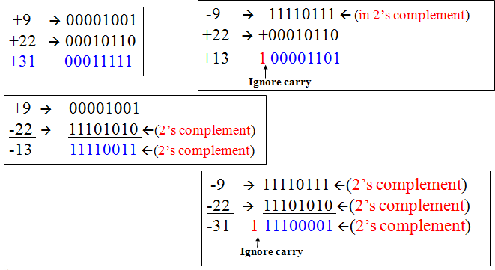
Examples of 2’s complement addition

Slide 15
2’ complement subtraction of signed binary numbers
Take the 2’s complement of the subtrahend (number to be subtracted) and add it to the minuend (including their sign bits). Discard carry bit if any
Suppose, if both minuend and subtrahend are Negative numbers, convert them in to 2’s complement form and perform Addition! Discard carry bit if any.

Slide 16
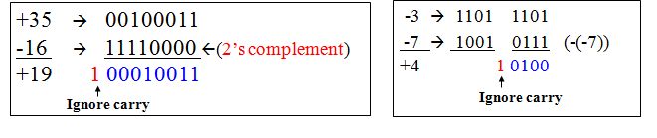

Slide 17
Binary arithmetic
Binary arithmetic is essential part of all the digital computers and many other digital system.
Binary Addition
It is a key for binary subtraction, multiplication, division. There are four rules of the binary addition.

Slide 18
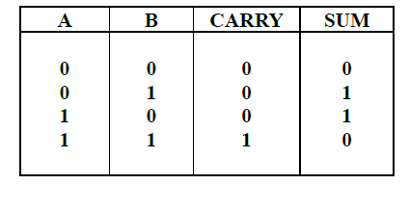
Binary Addition

Slide 19
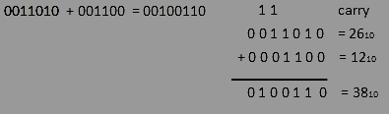
Binary Addition
In fourth case, a binary addition is creating a sum of (1+1=10) i.e. 0 is write in the given column and a carry of 1 over to the next column.
EXAMPLE - ADDITION

Slide 20
Binary Subtraction
Subtraction and Borrow, these two words will be used very frequently for the binary subtraction. There four rules of the binary subtraction. There are four rules of the binary Subtraction.

Slide 21
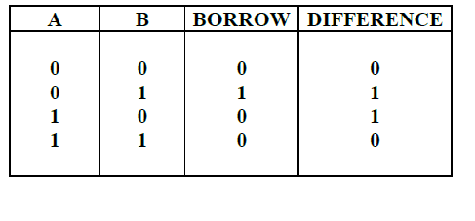
Binary Subtraction

Slide 22
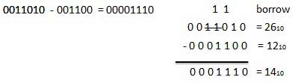
EXAMPLE - SUBTRACTION

Slide 23
Binary Multiplication
Binary multiplication is similar to decimal multiplication. It is simpler than decimal multiplication because only 0s and 1s are involved.There four rules of the binary multiplication.

Slide 24
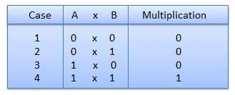
Binary Multiplication

Slide 25
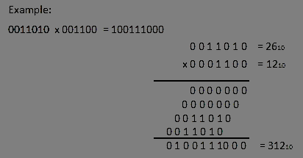
EXAMPLE - MULTIPLICATION

Slide 26
Binary Division
Binary division is similar to decimal division. It is called as the long division procedure

Slide 27
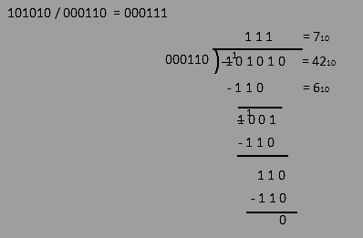
EXAMPLE - DIVISION

Slide 28
Half Adder
Half adder is a combinational logic circuit with two input and two output. The half adder circuit is designed to add two single bit binary number A and B. It is the basic building block for addition of two single bit numbers. This circuit has two outputs carry and sum.

Slide 29
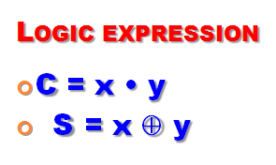
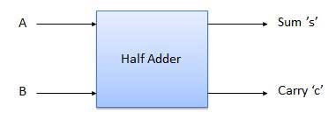
BLOCK DIAGRAM
X
A
Y
S
Y
B
XOR 2
A
Y
C
B
AND 2

Slide 30
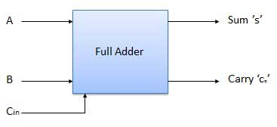
Full Adder
Full adder is developed to overcome the drawback of Half Adder circuit. It can add two one-bit numbers A and B, and carry c. The full adder is a three input and two output combinational circuit.

Slide 31
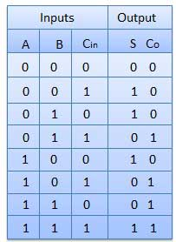
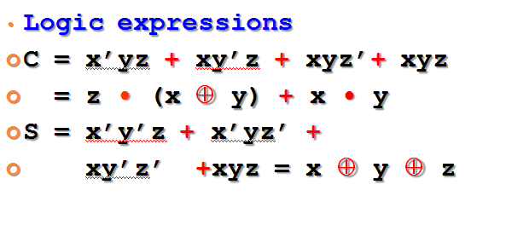
Full Adder

Slide 32
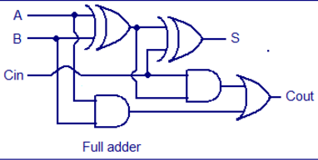
FULL ADDER: CIRCUIT DIAGRAM

Slide 33
Half Subtractors
Half subtractor is a combination circuit with two inputs and two outputs (difference and borrow). It produces the difference between the two binary bits at the input and also produces a output (Borrow) to indicate if a 1 has been borrowed. In the subtraction (A-B), A is called as Minuend bit and B is called as Subtrahend bit.

Slide 34
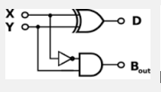
Truth table and circuit diagram
From the truth table, Boolean Expression can be derived as:
D = A’B + AB’ = A ⊕ B
B_{o} = A’B

Slide 35
Full Subtractors
The disadvantage of a half subtractor is overcome by full subtractor. The full subtractor is a combinational circuit with three inputs A,B,C and two output D and C'. A is the minuend, B is subtrahend, C is the borrow produced by the previous stage, D is the difference output and C' is the borrow output.

Slide 36
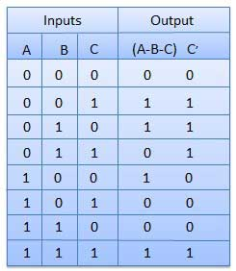
TRUTH TABLE

Slide 37
Logic Equation:
D=A®B®C
B=A’B+(A®B)’C

Slide 38
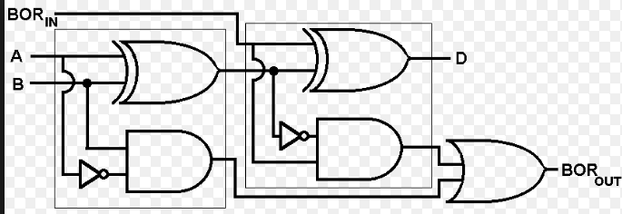
Circuit Diagram

Slide 39
Ripple Carry Adder
Typical Ripple Carry Addition is a Serial Process:
• Addition starts by adding LSBs of the augend and addend.
• Then next position bits of augend and addend are added along with the carry (if any) from the preceding bit.
• This process is repeated until the addition of MSBs is completed.

Slide 40
Carry Propagation
• Speed of a ripple adder is limited due to carry propagation or carry ripple.
• Sum of MSB depends on the carry generated by LSB.
For example.
4-bit Carry Ripple Adder

Slide 41
Carry Propagation
Assume you want to add two operands A and B where
A= A3 A2 A1 A0
B=B3 B2 B1 B0
For example: A= 1 0 1 1 +
B= 1 1 0 1
---------------
A+B= 11 0 0 0 = C out S3 S2 S1 S0

Slide 42
Carry Propagation
From the example above it can be seen that we are adding 3 bits at atime sequentially until all bits are added. A full adder is a combinational circuit that performs the arithmetic sum of three input bits: augends Ai, addend Bi and carry in Cin from the previous adder. Its results contain the sum Si and the carry out, Cout to the next stage.

Slide 43
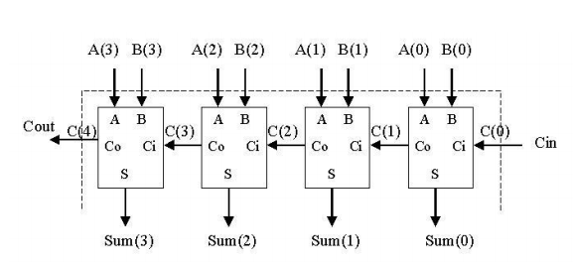
4-Bit Adder

Slide 44
4 BIT ADDER
So to design a 4-bit adder circuit we start by designing the 1 –bit full adder then connecting the four 1-bit full adders to get the 4-bit adder as shown in the diagram above. For the 1-bit full adder, the design begins by drawing the Truth Table for the three input and the corresponding output SUM and CARRY. The Boolean Expression describing the binary adder circuit is then deduced. The binary full adder is a three input combinational circuit which satisfies the truth table below.

Slide 45
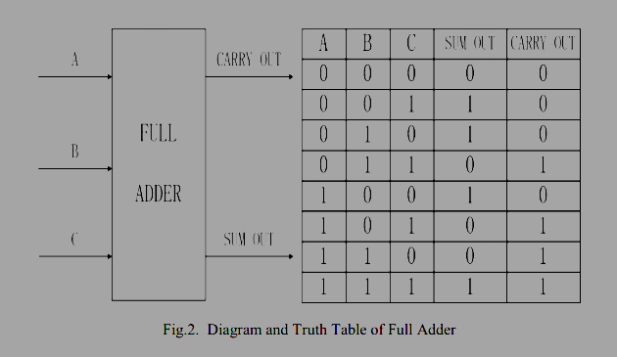
Full adder

Slide 46
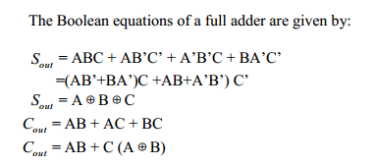
Full adder

Slide 47
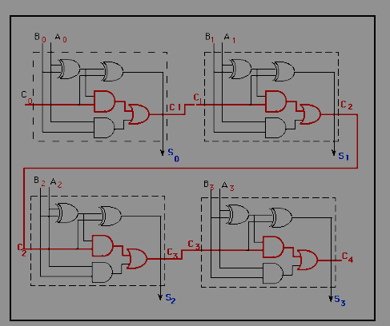
Full adder

Slide 48
Design of Fast adder: carry-lookahead adders
A carry-lookahead adders (CLA) is a type of adder used in digital logic. A carry-lookahead adder improves speed by reducing the amount of time required to determine carry bits.
It can be contrasted with the simpler, but usually slower,ripple carry adder for which the carry bit is calculated alongside the sum bit, and each bit must wait until the previous carry has been calculated to begin calculating its own result and carry bits (see adder for detail on ripple carry adders).

Slide 49
The carry-lookahead adder calculates one or more carry bits before the sum, which reduces the wait time to calculate the result of the larger value bits.
In a ripple adder the delay of each adder is 10 ns , then for 4 adders the delay will be 40 ns .
To overcome this delay Carry Look-Ahead Adder is used

Slide 50
carry-lookahead adders
Accordingly, reducing the carry propagation delay of adders is of great importance. Different logic design approaches have been employed to overcome the carry propagation problem.
One widely used approach employs the principle of carry look-ahead solves this problem by calculating the carry signals in advance, based on the input signals.

Slide 51
carry-lookahead adders
This type of adder circuit is called as carry look-ahead adder (CLA adder). It is based on the fact that a carry signal will be generated in two cases:
(1) when both bits Ai and Bi are 1, or
(2) when one of the two bits is 1 and the carry-in (carry of the previous stage) is 1.

Slide 52
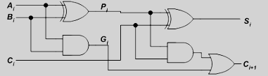
The Figure shows the full adder circuit used to add the operand bits in the I th column; namely Ai & Bi and the carry bit coming from the previous column (Ci ).

Slide 53


In this circuit, the 2 internal signals Pi and Gi are given by:
The output sum and carry can be defined as :

Slide 54
Gi is known as the carry Generate signal since a carry (Ci+1) is generated whenever Gi =1, regardless of the input carry (Ci).
Pi is known as the carry propagate signal since whenever Pi =1, the input carry is propagated to the output carry, i.e., Ci+1. = Ci (note that whenever Pi =1, Gi =0).

Slide 55
Computing the values of Pi and Gi only depend on the input operand bits (Ai & Bi) as clear from the Figure and equations.
Thus, these signals settle to their steady-state value after the propagation through their respective gates.

Slide 56
Computed values of all the Pi’s are valid one XOR-gate delay after the operands A and B are made valid.
Computed values of all the Gi’s are valid one AND-gate delay after the operands A and B are made valid.
The Boolean expression of the carry outputs of various stages can be written as follows:

Slide 57
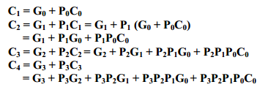

Slide 58
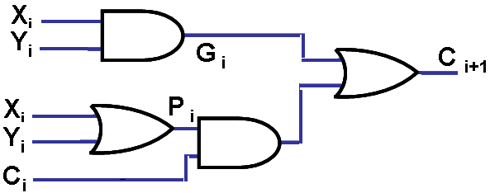
Carry C_{i+1} = X_{i}Y_{i} + Y_{i}C_{i} + C_{i}X_{i}
= X_{i}Y_{i} + C_{i} (X_{i} +Y_{i})
= G_{i} + C_{i}P_{i}. (Generate Carry + C_{i}* Propagate Carry)
Carry C_{i+1} = G_{i} + C_{i}P_{i}
i.e. C_{i} = (G_{i-1} + P_{i-1}C_{i-1}) &
C_{i-1} = (G_{i-2} + P_{i-2}C_{i-2}).

Slide 59
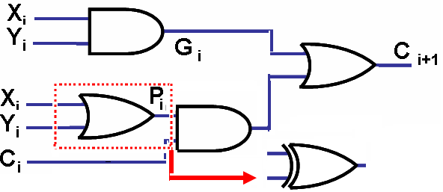
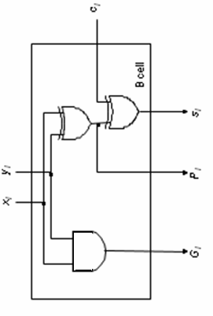
C_{i+1} = G_{i} + C_{i}P_{i}.
always, except when X_{i} = 1 & Y_{i} = 1. But, then Gi = 1to make C_{i+1} = 1; hence Bit cell

Slide 60
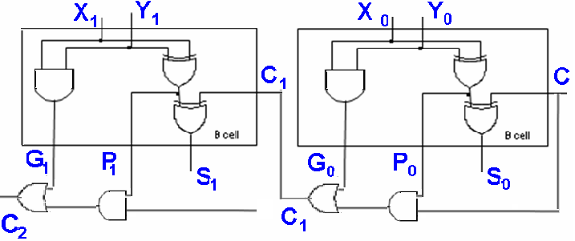
In general C _{i+1} = G _{i} + P_{i}G _{i-1} +
P_{i}P _{i-1} G _{i-2} + … + P_{i} P _{i-1} ……….P ₁G₀ + P_{i} P _{i-1} … P₀G_{0.}
C_{i+1}-- in 3 Gates delay; S_{i} – in 4 Gates delay irrespective of n. C₁ in 3 gates delay,C₂ in 3 gates delay,C₃ in 3 gates delay and so on. S₀ in 4 gates delay, S₁ in 4 gates delay, S₂ in 4 gates delay and so on.

Slide 61
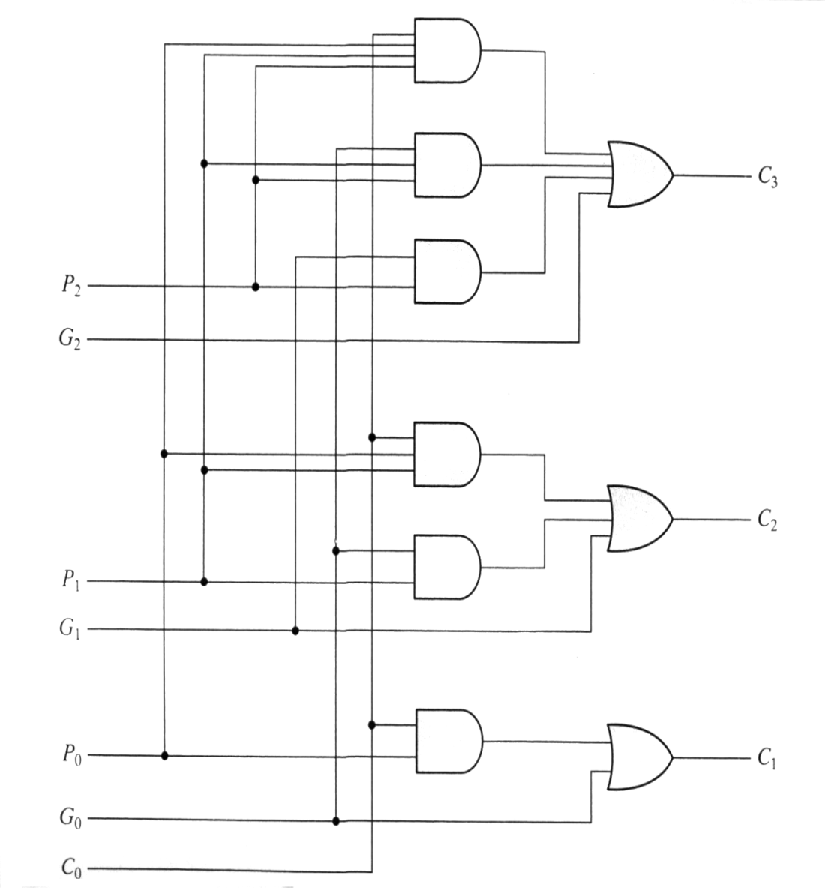
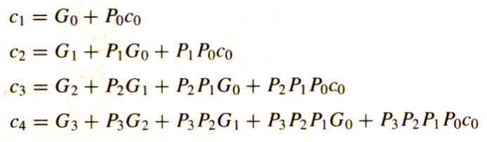
Implementing these expressions (for a 4-bit adder), results in the logic diagram. (IC- 74182)

Slide 62
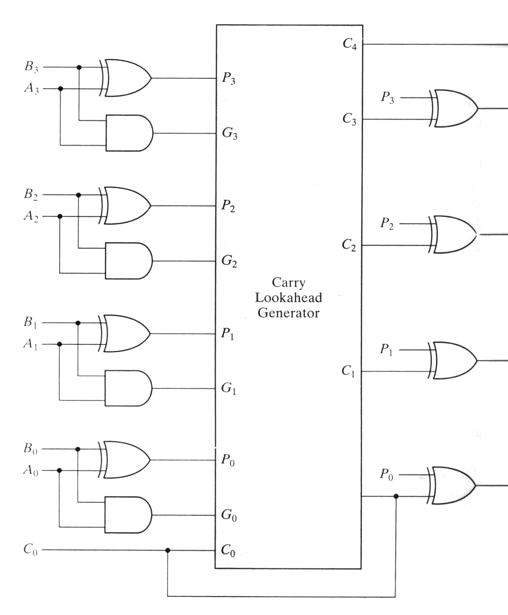

4 bit carry look ahead
Adder:
C4
S3
4 bit carry look ahead
Adder:
S2
S1
S0

Slide 63
4 bit carry look ahead
Adder:
independent of n,
the n-bit addition process requires only four gate delays (against 2n)
increasing ‘n’ increases gate fan-in requirements (C 4 – fan_in = 5)
Longer version adders - cascading

Slide 64
MULTIPLICATION OF POSITIVE NUMBERS
The product of two n-digit numbers can be accommodated in 2n digits, so the product of the two 4-bit numbers in this example fits into 8 bits.
In the binary system, multiplication by the multiplier bit ‘1’ means the multiplicand is entered in the appropriate position to be added to the partial product.
Binary multiplication of positive operands can be implemented in a combinational (speed up) two-dimensional logic array
Here, M- indicates multiplicand, Q- indicates multiplier & P- indicates partial product. The basic component in each cell is a full adder FA. The AND gate in each cell determines whether a multiplicand bit mj, is added to the incoming partial-product bit, based on the value of the multiplier bit, q_{i}.

Slide 65
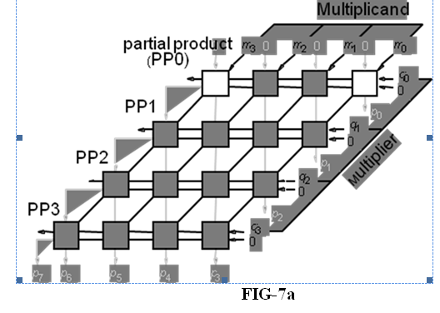
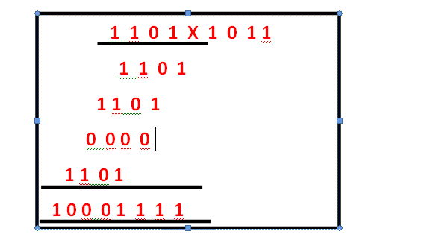

Slide 66
Binary Multiplier:
Multiplication of binary numbers is performed in the same way as with decimal numbers. The multiplicand is multiplied by each bit of the multiplier, starting from the least significant bit.
The result of each such multiplication forms a partial product. Successive partial products are shifted one bit to the left.

Slide 67
Binary Multiplier:
The product is obtained by adding these shifted partial products.
Example 1: Consider an example of multiplication of two numbers, say A and B (2 bits each),
C = A x B.

Slide 68
Binary Multiplier:
Unsigned number multiplication
two n-bit numbers; 2n-bit result
(13) 1 1 0 1 X 1 0 1 1 (11)
1 1 0 1
1 1 0 1
0 0 0 0
1 1 0 1
1 0 0 0 1 1 1 1 (143)

Slide 69
Binary Multiplier:
The first partial product is formed by multiplying the B1B0 by A0. The multiplication of two bits such as A0 and B0 produces a 1 if both bits are 1; otherwise it produces a 0 like an AND operation. So the partial products can be implemented with AND gates.

Slide 70
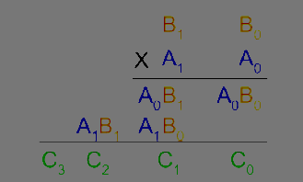
Binary Multiplier:
The second partial product is formed by multiplying the B1B0 by A1 and is shifted one position to the left.

Slide 71
Binary Multiplier:
The two partial products are added with two half adders (HA). Usually there are more bits in the partial products, and then it will be necessary to use FAs.

Slide 72
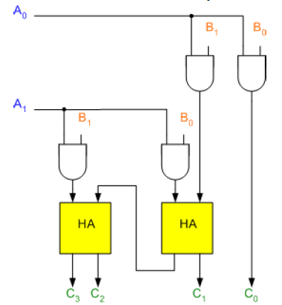
Binary Multiplier:

Slide 73
Binary Multiplier:
The least significant bit of the product does not have to go through an adder, since it is formed by the output of the first AND gate as shown in the Figure.

Slide 74
Shift – and – Add multiplier :
Shift-and-add multiplication is similar to the multiplication performed by paper and pencil. This method adds the multiplicand X to itself Y times, where Y denotes the multiplier. To multiply two numbers by paper and pencil, the algorithm is to take the digits of the multiplier one at a time from right to left, multiplying the multiplicand by a single digit of the multiplier and placing the intermediate product in the appropriate positions to the left of the earlier results.

Slide 75
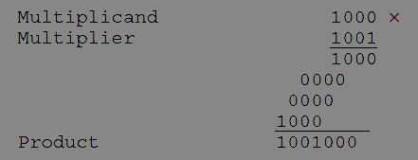
Shift – and – Add multiplier :
As an example, consider the multiplication of two unsigned 4-bit numbers,
8 (1000) and 9 (1001).

Slide 76
Shift – and – Add multiplier :
In the case of binary multiplication, since the digits are 0 and 1, each step of the multiplication is simple. If the multiplier digit is 1, a copy of the multiplicand (1 ×multiplicand) is placed in the proper positions; if the multiplier digit is 0, a number of 0 digits (0 × multiplicand) are placed in the proper positions.
Consider the multiplication of positive numbers. The first version of the multiplier circuit, which implements the shift-and-add multiplication method for two n-bit numbers, is shown in Figure

Slide 77
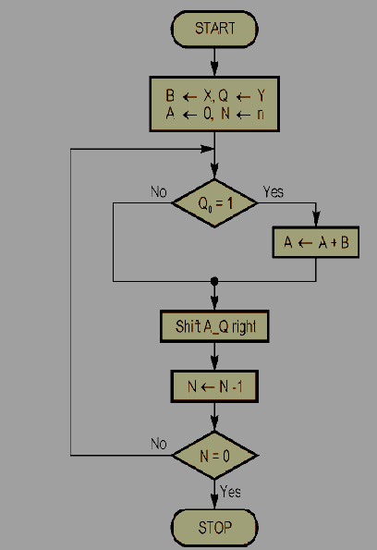
Shift – and – Add multiplier :

Slide 78
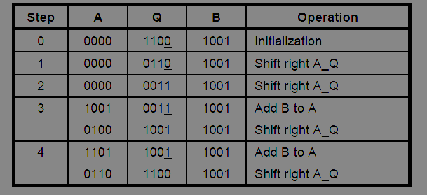
For Example, Perform the multiplication 9 x 12 (1001 x 1100). Finally, both A and Q contains the result of product.

Slide 79
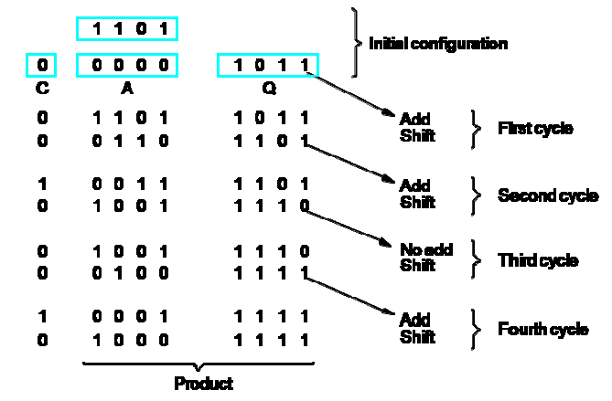
Shift – and – Add multiplier :
Another Example.
A = 0000 M ( Multiplicand) 🡪 13 ( 1 1 0 1) Q(Multiplier) 🡪 11 (1 0 1 1)

Slide 80
Signed Multiplication Booth Algorithm
A powerful algorithm for signed –number multiplication is a Booth’s algorithm which generates a 2n bit product and treats both positive and negative numbers uniformly. This algorithm suggest that we can reduce the number of operations required for multiplication by representing multiplier as a difference between two numbers.

Slide 81
Booth algorithm
Booth Recoding:
30₁₀ : 0 1 1 1 1 0 0
+1 0 0 0 -1 0
(ii) 100₁₀: 0 1 1 0 0 1 0 0 0
+1 0 -1 0 +1 -1 0 0
(iii) 985₁₀: 0 0 1 1 1 1 0 1 1 0 0 1 0
0 +1 0 0 0 -1 +1 0 -1 0 +1 -1

Slide 82
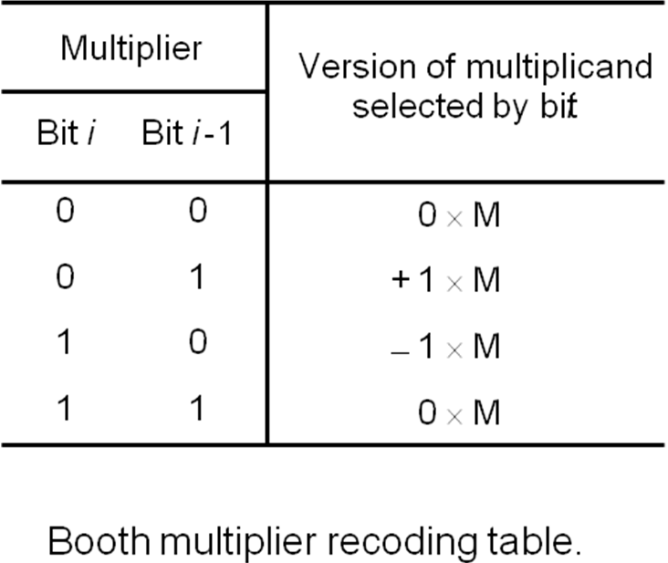
Booth multiplier recoding table:

Slide 83
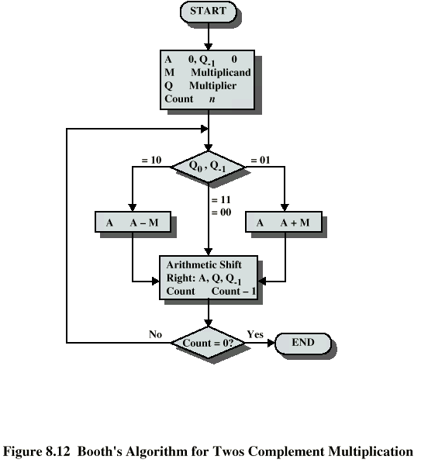

Slide 84
Booth algorithm
Booth algorithm treats both +ve &
-ve operands equally.
(a) + Md X + Mr
Ex: 0 1 1 0 1 (+13) X 0 1 0 1 1 (+11)
+1-1+1 0 -1
1 1 1 1 1 1 0 0 1 1
0 0 0 0 0 0 0 0 0
0 0 0 0 1 1 0 1
1 1 1 0 0 1 1
0 0 1 1 0 1
0 0 1 0 0 0 1 1 1 1 (+143)

Slide 85
Booth algorithm
Booth algorithm treats both +ve &
-ve operands equally.
(b) - Md X + Mr
Ex: 1 0 0 1 1 (-13) X 0 1 0 1 1 (+11)
+1-1+1 0 -1
0 0 0 0 0 0 1 1 0 1
0 0 0 0 0 0 0 0 0
1 1 1 1 0 0 1 1
0 0 0 1 1 0 1
1 1 0 0 1 1
1 0 1 0 0 0 0 0 0 1 (-143)

Slide 86
Booth algorithm
Booth algorithm treats both +ve &
-ve operands equally.
(c) + Md X - Mr
Ex: 0 1 1 0 1 (+13) X 1 0 1 0 1 (-11)
-1+1-1 +1-1
0 0 0 0 0 0 0 0 0 0
1 1 1 1 1 1 0 0 1 1
0 0 0 0 0 1 1 0 1
1 1 1 1 0 0 1 1
0 0 0 1 1 0 1
1 1 0 0 1 1
1 1 0 1 1 1 0 0 0 1 1 0 1 0 0 0 1 1 1 1 (-143)

Slide 87
Booth algorithm
Booth algorithm treats both +ve &
-ve operands equally.
(d) - Md X - Mr
Ex: 1 0 0 1 1 (-13) X 0 0 1 0 1 (-11)
-1+1-1 +1 -1
0 0 0 0 0 0 0 0 0 0
0 0 0 0 0 0 1 1 0 1
1 1 1 1 1 0 0 1 1
0 0 0 0 1 1 0 1
1 1 1 0 0 1 1
0 0 1 1 0 1
0 0 1 0 0 0 1 1 1 1 (+143)

Slide 88
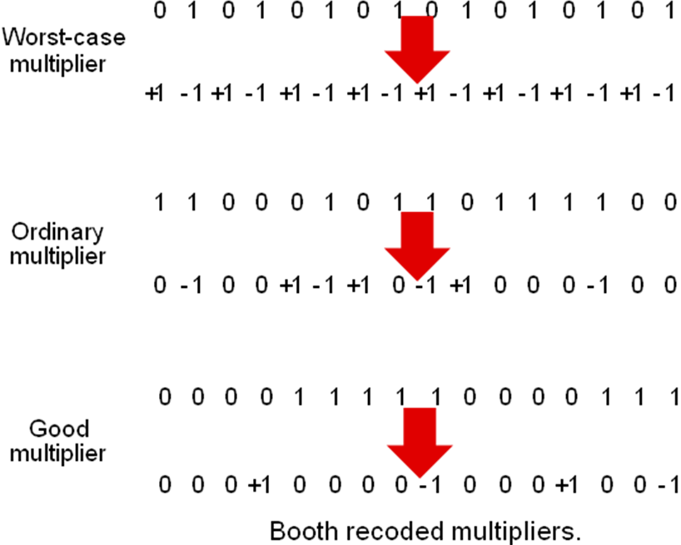
Count = 4 Vs 8 speed improvement
Count = 7 Vs 9 no speed improvement
Count = 16 Vs 8 speed worsened.
On an average no improvement in speed

Slide 89
FAST MULIPLICATION:
There are two techniques for speeding up the multiplication operation.
The first technique guarantees that the maximum number of summands (versions of the multiplicand) that must be added is n/2 for n-bit operands.
The second technique reduces the time needed to add the summands (carry-save addition of summands method).

Slide 90
Bit-Pair Recoding of Multipliers
This bit-pair recoding technique halves the maximum number of summands. It is derived from the Booth algorithm.
Group the Booth-recoded multiplier bits in pairs, and observe the following: The pair (+1 -1) is equivalent to the pair (0 +1).
That is, instead of adding —1 times the multiplicand M at shift position i to + 1 x M at position i + 1, the same result is obtained by adding +1 x M at position I Other examples are: (+1 0) is equivalent to (0 +2),(-l +1) is equivalent to (0 —1). and so on

Slide 91
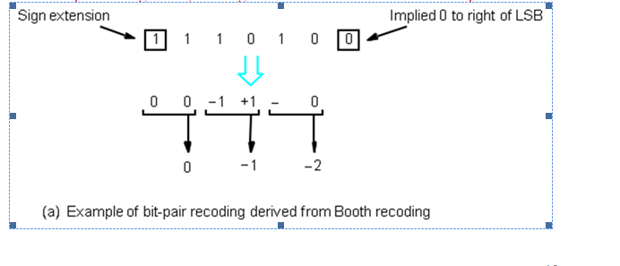

Slide 92
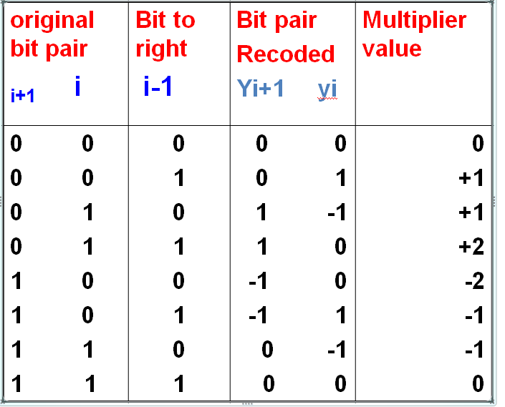

Slide 93
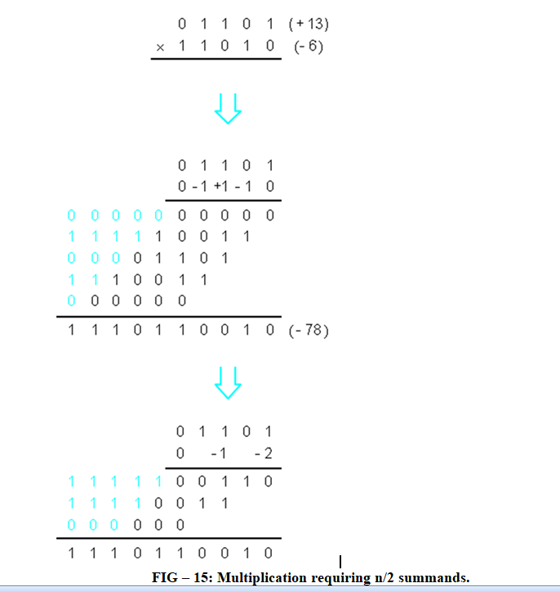

Slide 94
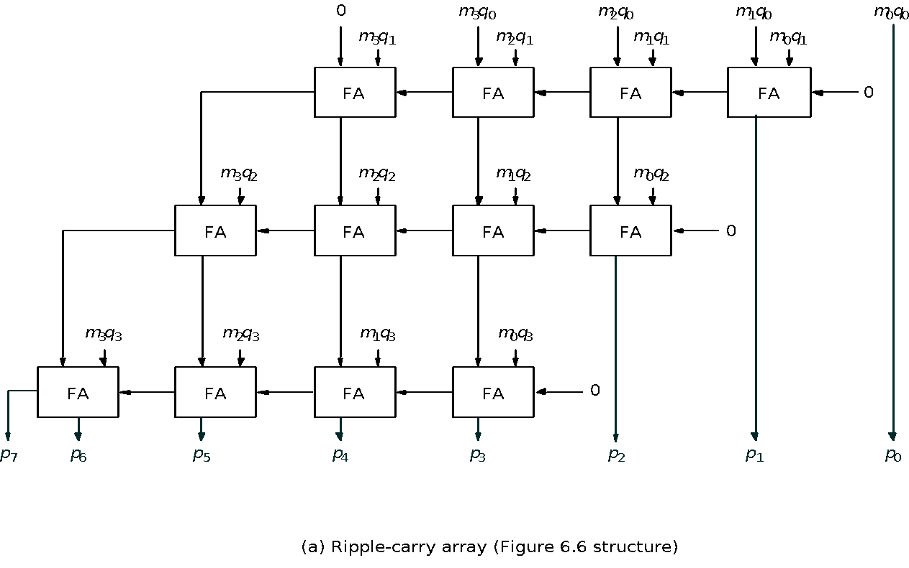
. CARRY SAVE ADDITION method

Slide 95
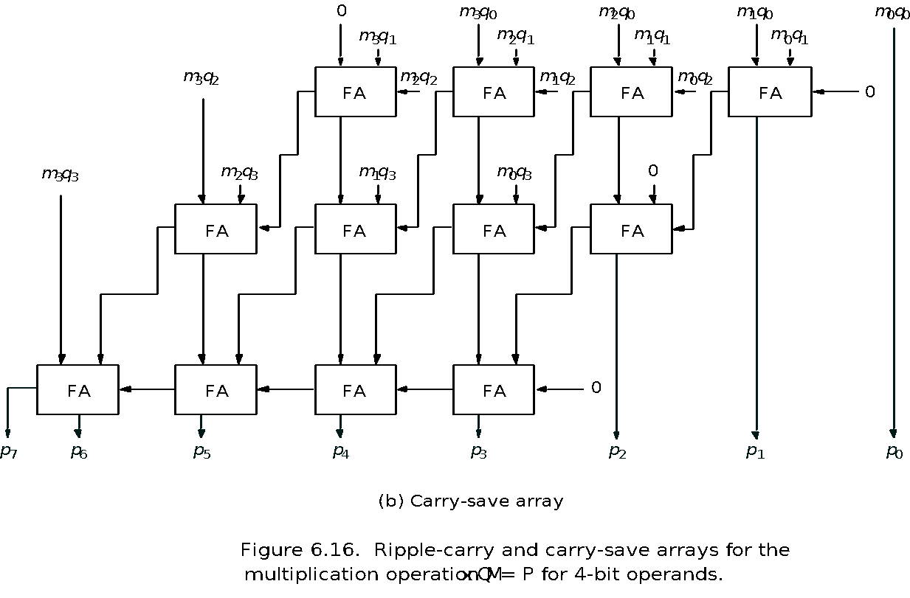
CARRY SAVE ADDITION method

Slide 96
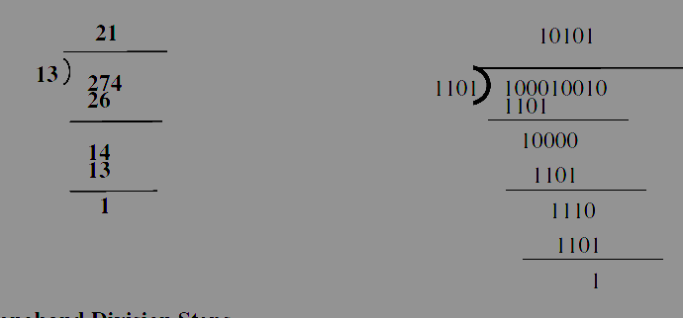
Integer division
Integer Division
Manual Division

Slide 97
Integer division
Longhand Division Steps
Position the divisor appropriately with respect to the dividend and performs a subtraction.
If the remainder is zero or positive, a quotient bit of 1 is determined, the remainder is extended by another bit of the dividend, the divisor is repositioned, and another subtraction is performed.
If the remainder is negative, a quotient bit of 0 is determined, the dividend is restored by adding back the divisor, and the divisor is repositione for another subtraction.

Slide 98
Restoring Division
Similar to multiplication circuit
N-bit positive divisor is loaded into register M and an n-bit positive dividend is loaded into register Q at the start of the operation.
Register A is set to 0

Slide 99
Restoring Division
After the division operation is complete, the n-bit quotient is in register Q and the remainder is in register A.
The required subtractions are facilitated by using 2’s complement arithmetic.
The extra bit position at the left end of both A and M accomodates the sign bit during subtraction.
Shift A and Q left one binary position
Subtract M from A, and place the answer back in A

Slide 100
Restoring Division
If the sign of A is 1, set q0 to 0 and add M back to A (restore A); otherwise, set q0 to 1
Repeat these steps n times

Slide 101
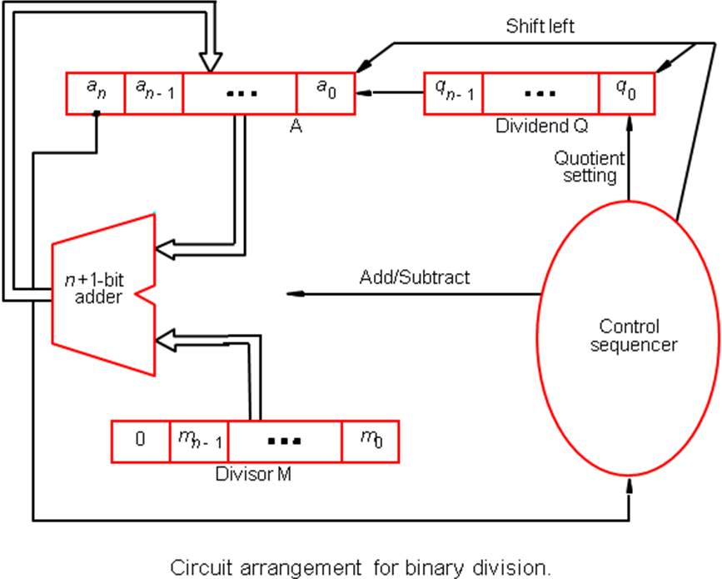
Division:

Slide 102

Restoring Division

Slide 103

Algorithm for Non-restoring division is given in below image :

Slide 104
Algorithm for Non-restoring division
In this problem,
Dividend (A) = 101110, ie 46, and Divisor (B) = 010111, ie 23.
Initialization :
Set Register A = Dividend = 000000
Set Register Q = Dividend = 101110
( So AQ = 000000 101110 ,
Q0 = LSB of Q = 0 )
Set M = Divisor = 010111, M' = 2's complement of M = 101001

Slide 105
Algorithm for Non-restoring division
Set Count = 6, since 6 digits operation is being done here.
After this we start the algorithm, which I have shown in a table below :
In table, SHL(AQ) denotes shift left AQ by one position leaving Q0 blank.
Similarly, a square symbol in Q0 position denote, it is to be calculated later

Slide 106


Slide 107

Floating-Point Numbers and Operations
Floating – point arithmetic is an automatic way to keep track of the radix point.
FLOATING-POINT DATA
Floating-point representation of numbers needs two registers. The first represents a signed fixed-point number and the second, the position of the radix point. For example, the representation of the decimal number +6132.789 is as follows:

Slide 108
The first register has a 0 in the most significant flip-flop position to denote a plus
The magnitude of the number is stored in a binary code in 28 flip-flops, with each decimal digit occupying 4 flip-flops
The second register contains the decimal number + 4 (in binary code) to indicate that the actual position of the decimal point is four decimal positions to the right
This representation is equivalent to the number expressed by a fraction times 10 to an exponent, i.e., + 6132.789 is represented as +.6132789 x 10 ⁺⁴.

Slide 109

A floating-point binary number is similarly represented with two registers, one to store the coefficient and the other, the exponent. For example, the number + 1001.110 can be represented as follows:

Slide 110

IEEE Standard for Floating-Point Numbers:

Slide 111


